Slide 1
MEMBER ONLINE RENEW
Renew membership online through Legion.org.
2027

Slide 2
ONLINE RENEW
Notes:
Online renewal can be done through legion.org, mylegion.org or by using the Legion Plus app.

Slide 3
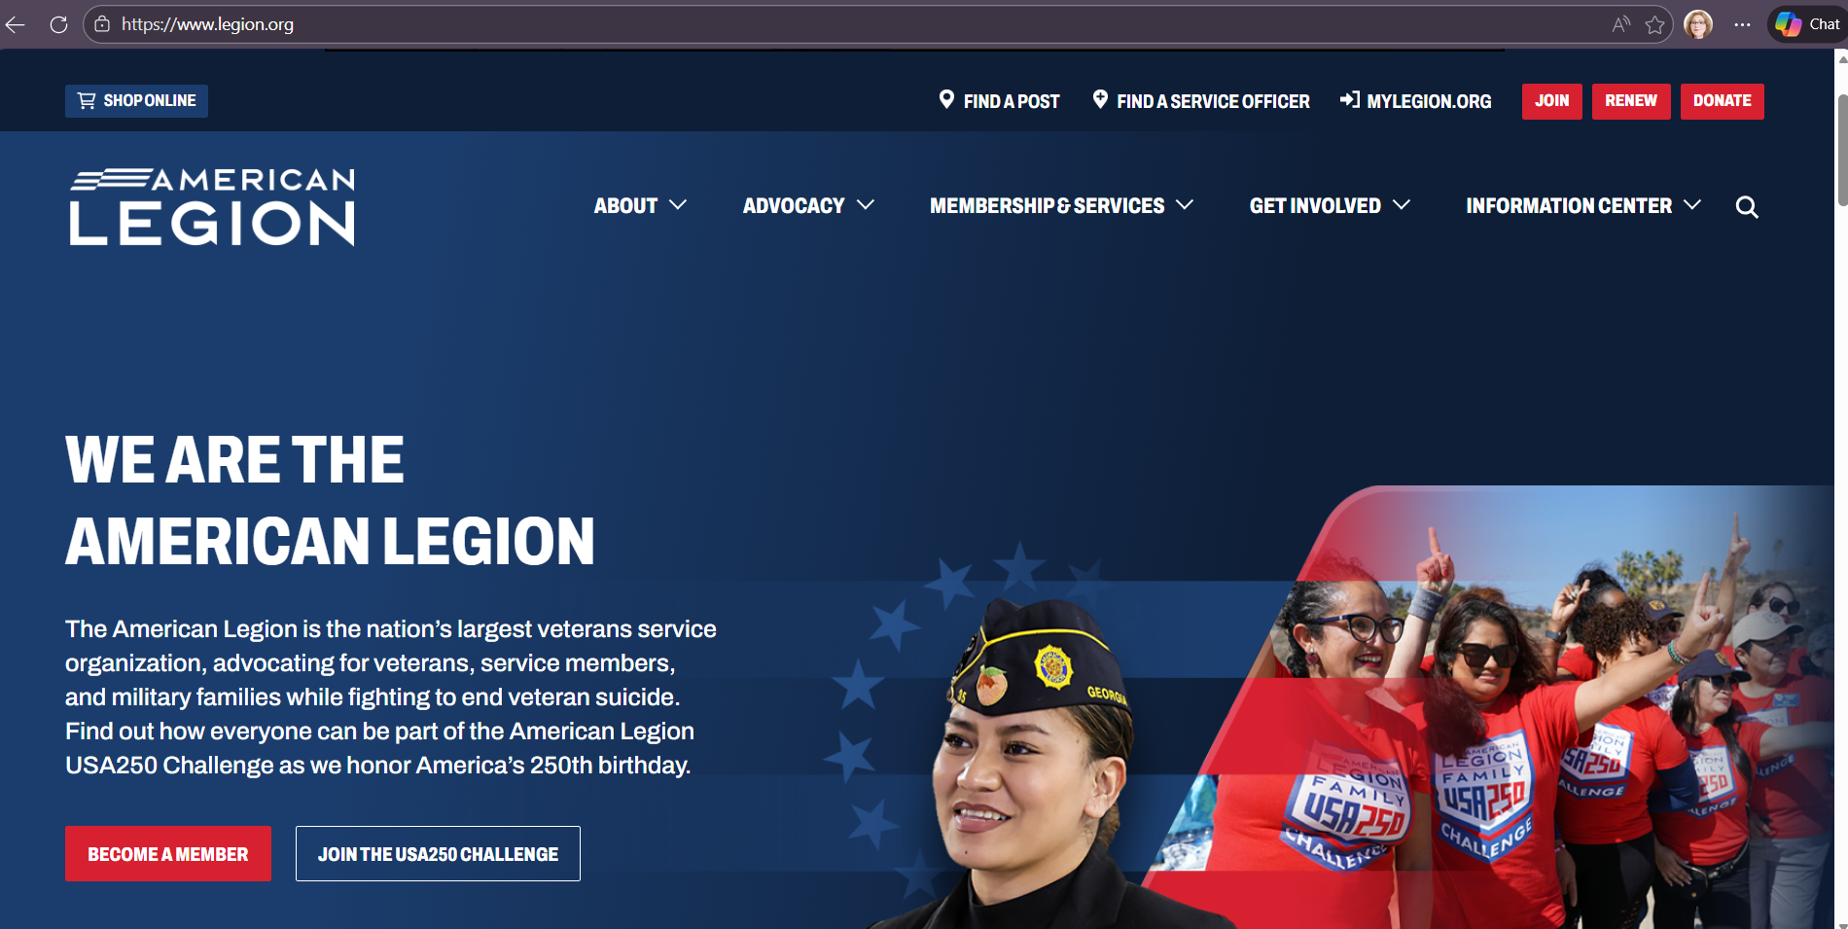

LEGION.ORG
Notes:
Legion.org provides a renewal link located at the top of the page.

Slide 4
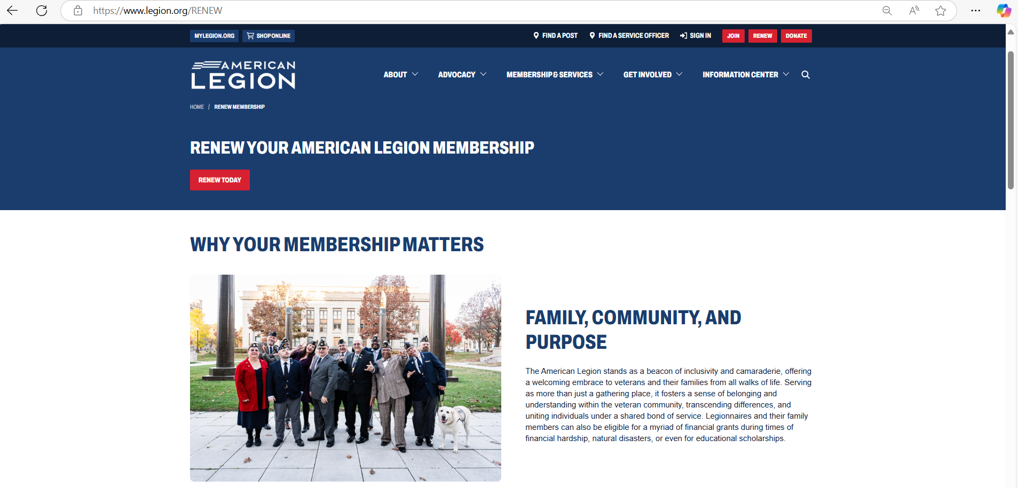

LEGION.ORG/RENEW
Notes:
Renewal notices will direct members to legion.org/renew. Click renew today to proceed.

Slide 5
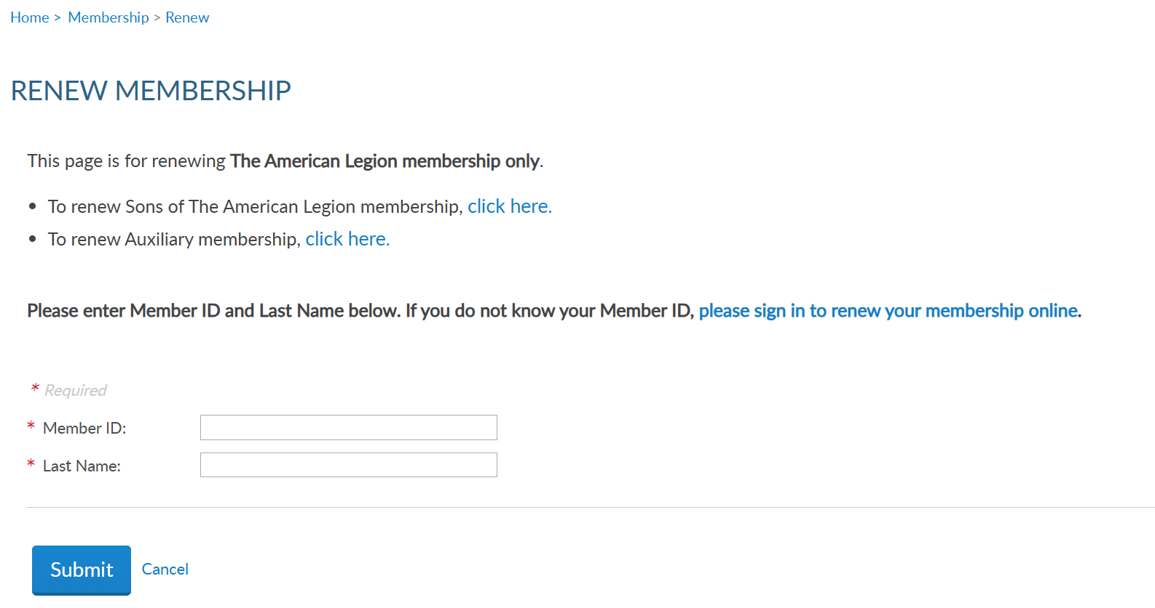
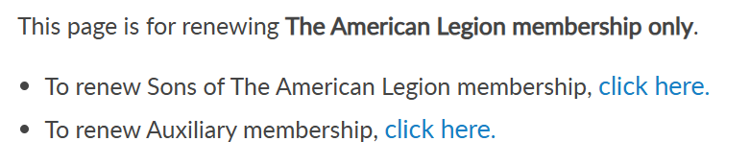
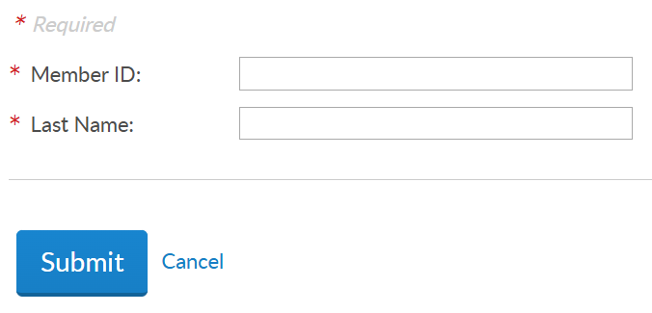
Notes:
The renewal window lands on Legion renewal with links to Sons of the American Legion, and Auxiliary renewal pages.
<1> Member ID and last name are required to begin renewal. Entering a suffix in last name will result in an error. Please enter last name only. Click submit to proceed.
Members who do not have their membership ID# are instructed to click the link to log in and renew through MyLegion.

Slide 6
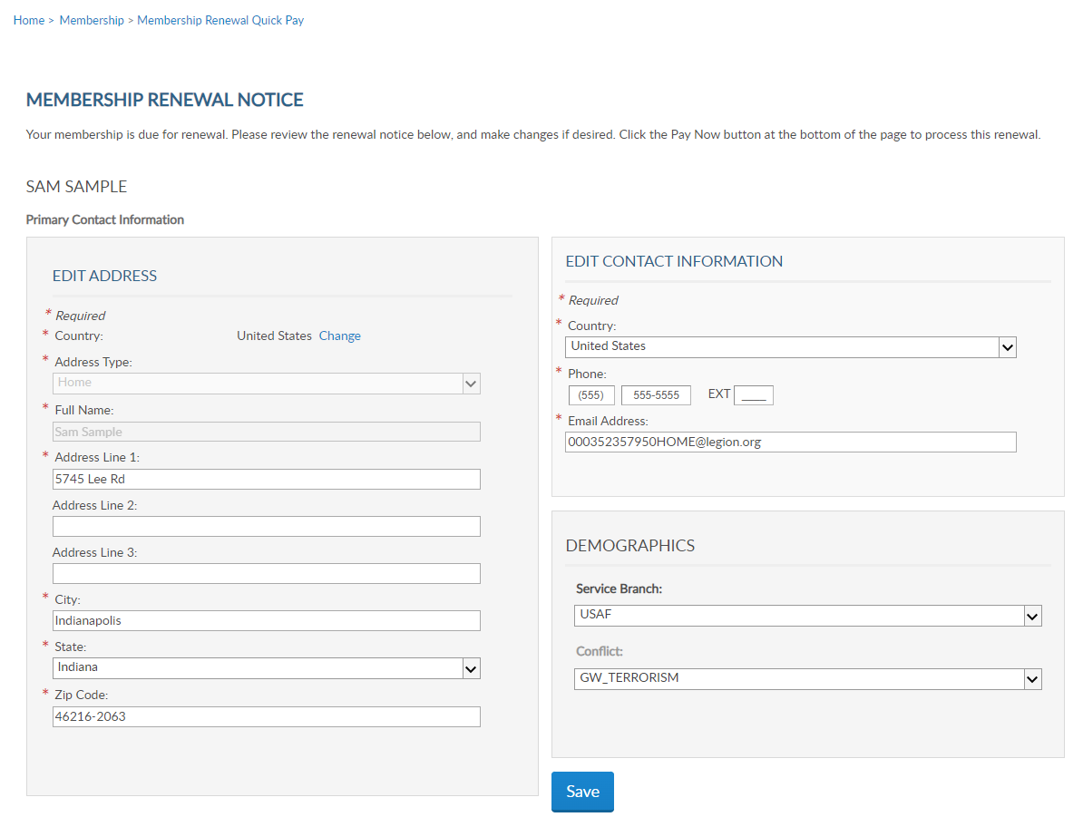
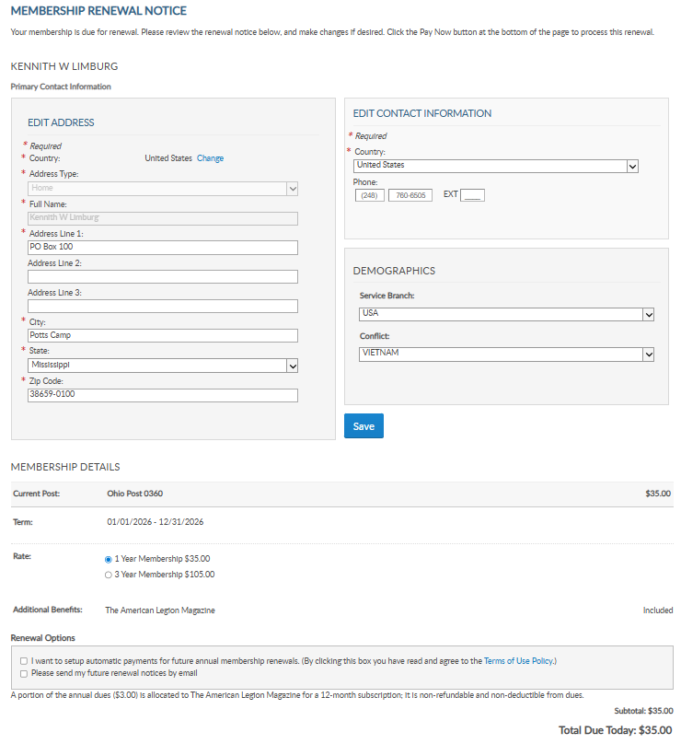
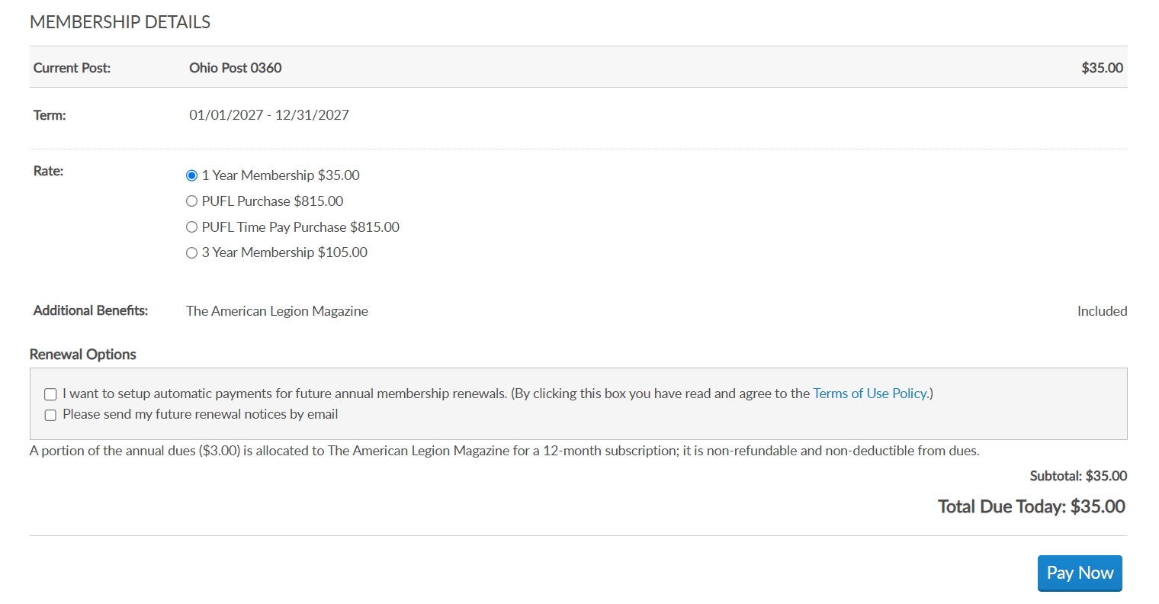
RENEWAL NOTICE
Review contact and demographic information.
Update or add and “Save”.
PrimaryEmail@address.com
PrimaryEmail@address.com
Notes:
Review the renewal notice opens. <1> Review and update contact and demographic information. A red asterisk indicates required fields. It is important to Save any updates in this area of the form. Scroll down to the lower half of the page for renewal options and select renewal rate.

Slide 7
RENEWAL NOTICE
3-YR and PUFL are available for Legion membership only.
Notes:
Legion members will have rate options to renew for 1 year, 3 year or paid up for life membership. Paid up for life rates only display if date of birth is on the member’s record.

Slide 8
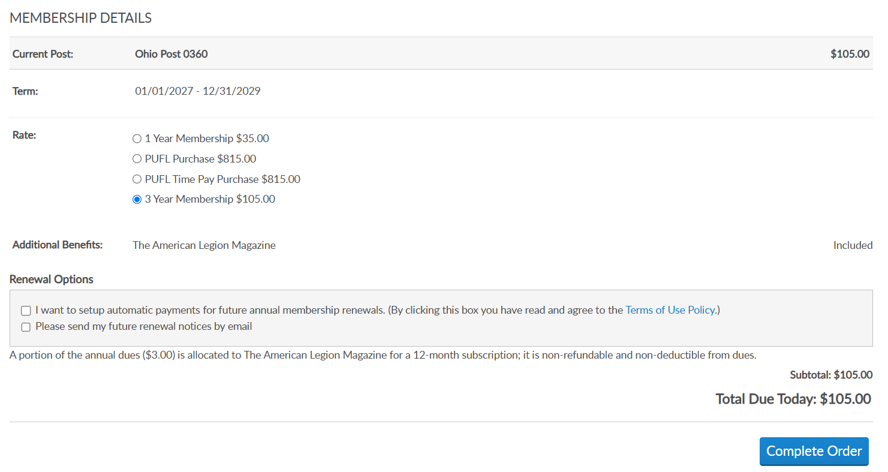
RENEWAL RATES
Notes:
Select 1 year membership for current year and the total due updates.

Slide 9
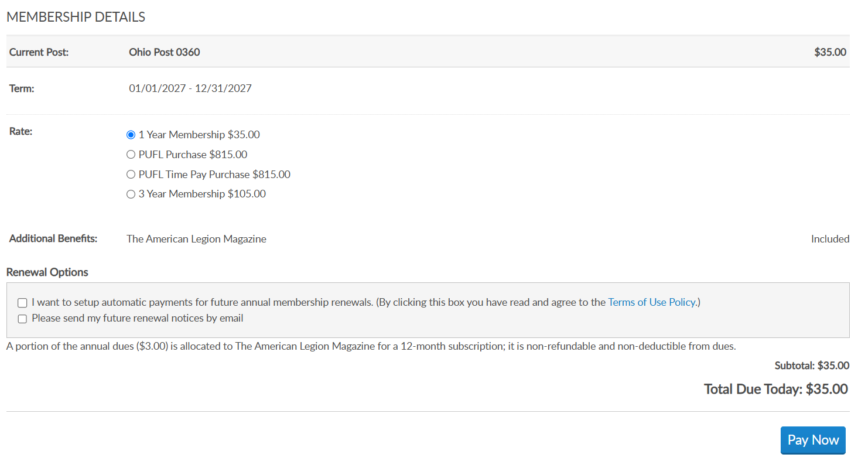
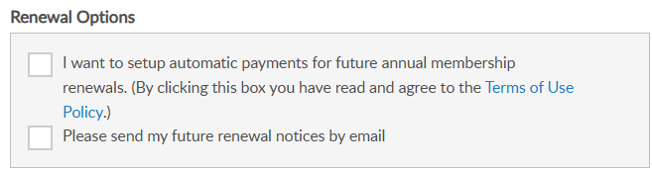
RENEWAL OPTIONS
Auto Renew
* Charges stored CC annually.
* Receive email notification reminder.
* Credit card information can be updated though MyLegion.org.
* Auto Renew with 3-yr purchase begins at end of 3-yr term.
* Do not receive renewal notices.
Notes:
Renewal options allow members to set automatic renewal and notice preferences. Signing up for auto allows you to store and manage credit information that will be automatically charged each renewal year. Notifications are emailed prior to charging the credit card on file. Credit card information can be updated at any time through MyLegion.
If you check automatic renew while opting for the 3-year term, the first auto renewal begins at the end of the 3 years. Future renewals will then be charged on an annual basis. Members enrolled in auto renew do not receive notices.
Members can also elect to receive renewal notices by email. Check the box to send future renewal notices by email.

Slide 10
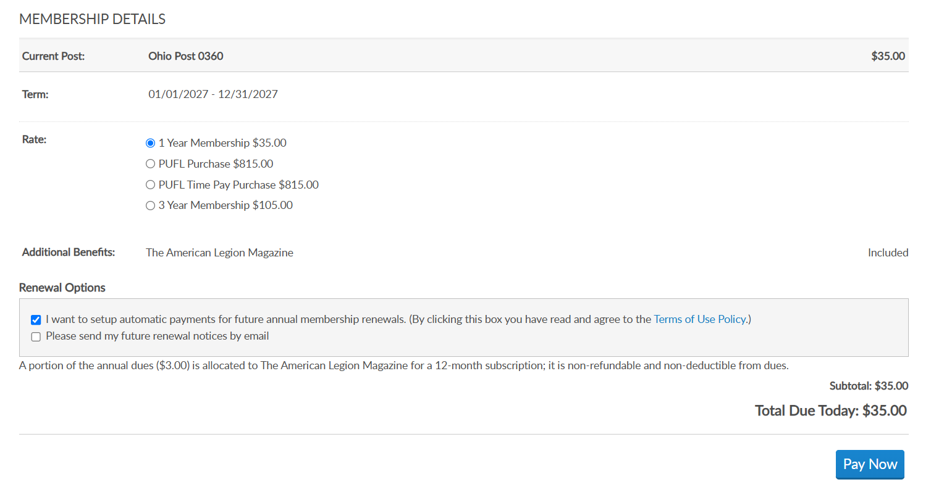
PAY NOW

Slide 11
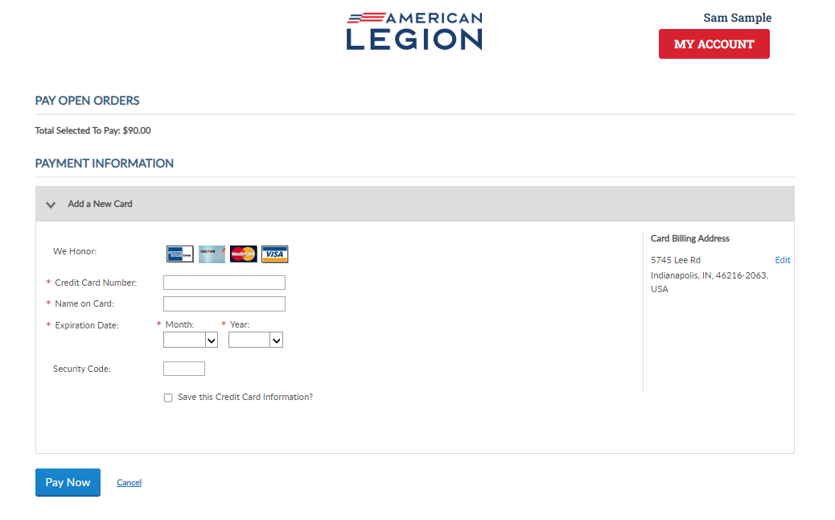
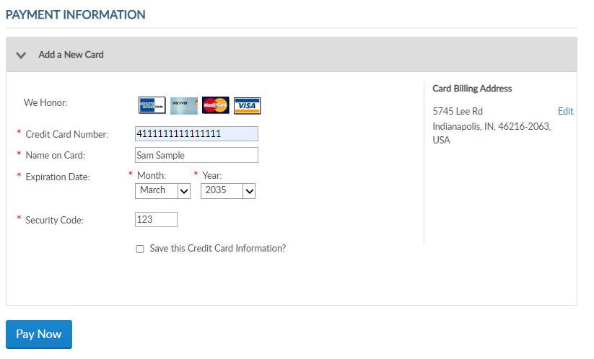
Total Selected to Pay: $35
Notes:
The payment window accepts credit card only. Enter valid credit card information. <1> Stored credit card information can be updated or removed from you MyLegion account.
Select Pay Now to continue.

Slide 12
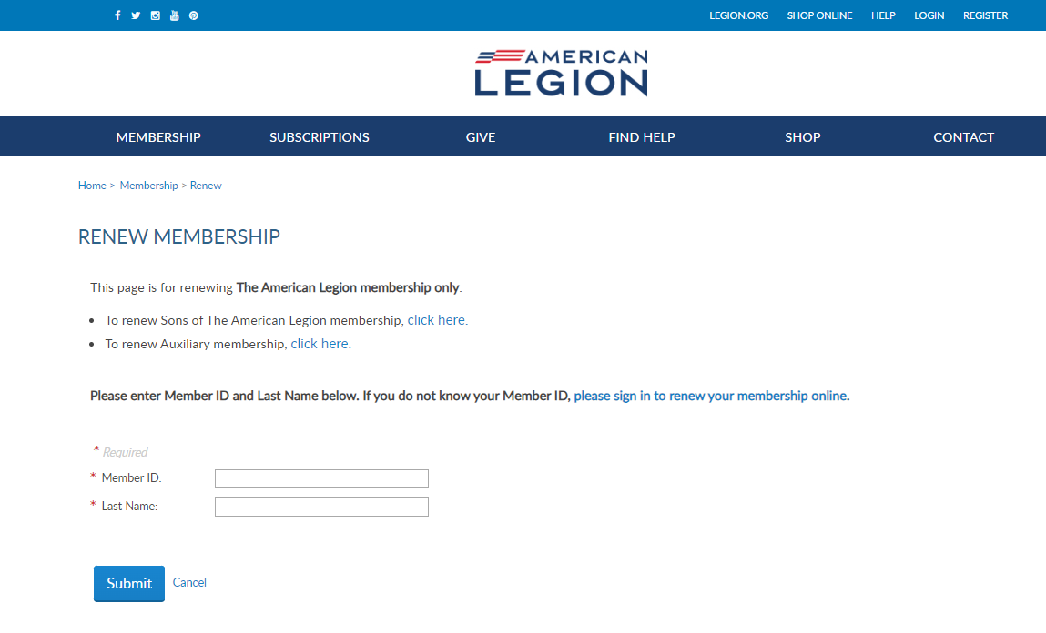
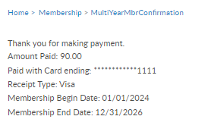
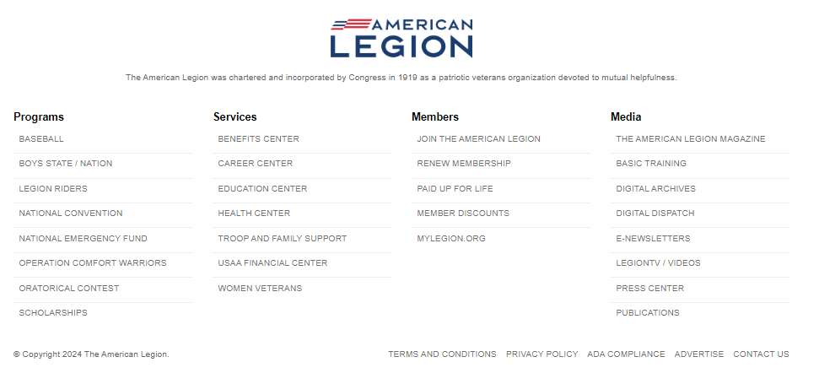
Thank you for making payment.
Amount Paid: 35.00
Paid with Card ending: ************1111
Receipt Type: Visa
Membership Begin Date: 01/01/2027
Membership End Date: 12/31/2027
Notes:
Thank you for your payment. You will receive a confirmation message with the amount paid and membership term dates. Posts are responsible for providing membership cards.
Membership cards can be printed through MyLegion.org. View and manage your membership through MyLegion.org. In the upper right click Login.

Slide 13

Notes:
Members can also renew using MyLegion.org.

Slide 14
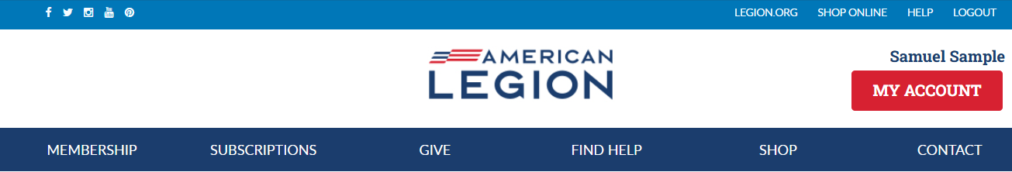
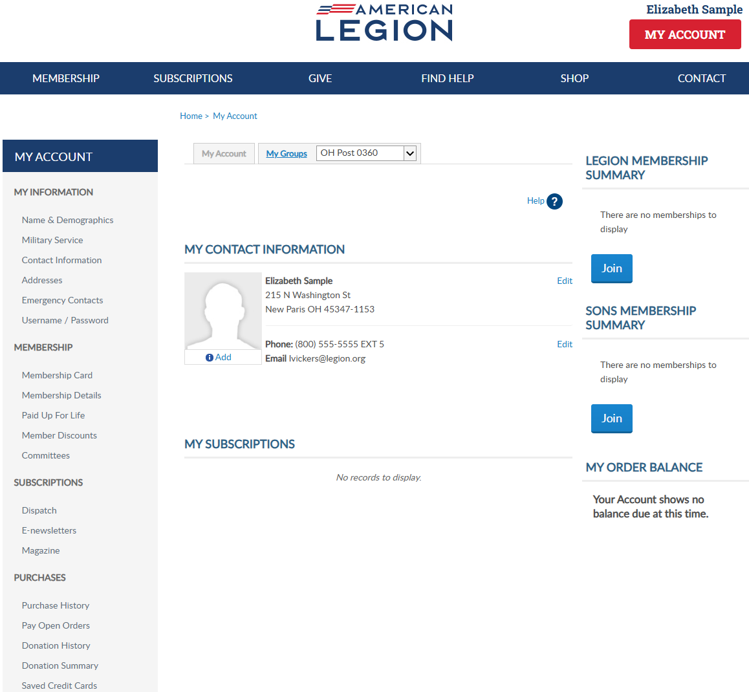
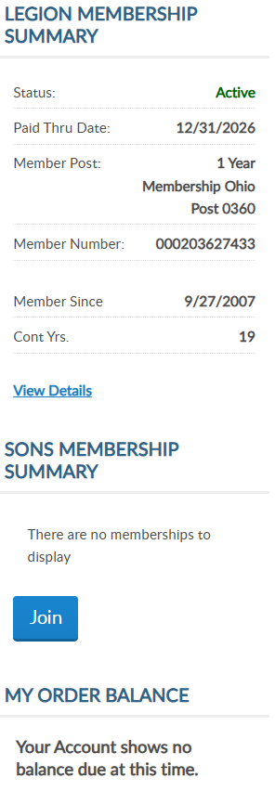
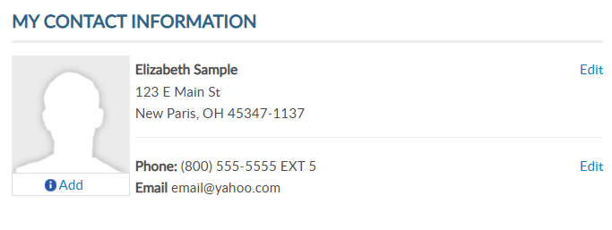
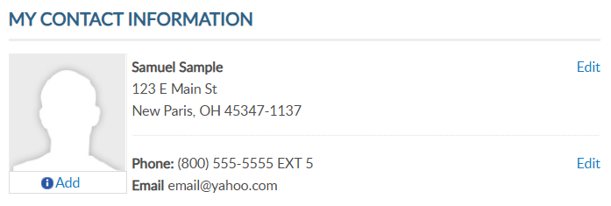
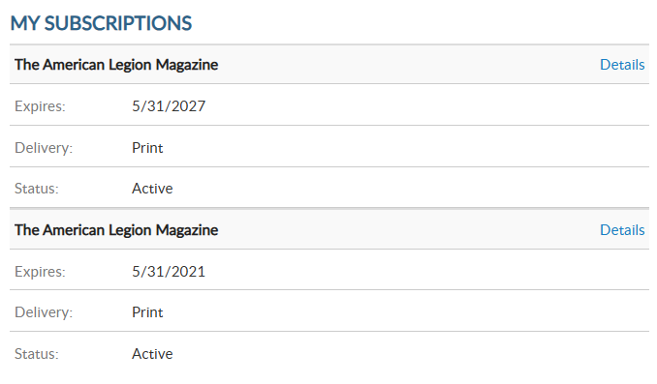
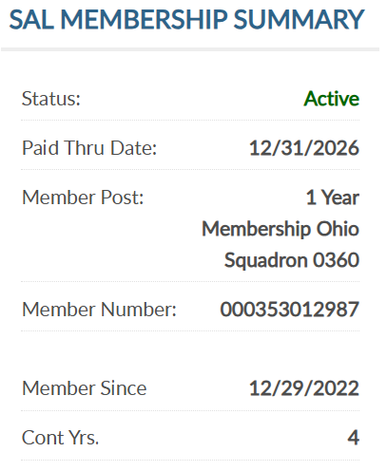
MYLEGION.ORG
Register with Email Address
Renew LGN and SAL
Manage Membership
Print Membership Cards
View Discounts
Administrative Tools for Officers
12/31/2027
000123456789
20
5/31/2028
12/31/2027
000123456789
5
Notes:
Register a myLegion account with the primary email address on your membership record to renew legion and sons of the american legion membership. When renewals are available, the renew now button will be active. This will take you through the renewal application.
<1>Mylegion allows members to manage their Membership, print cards, view discounts and includes administrative tools for post, squadron, county and district officers.

Slide 15
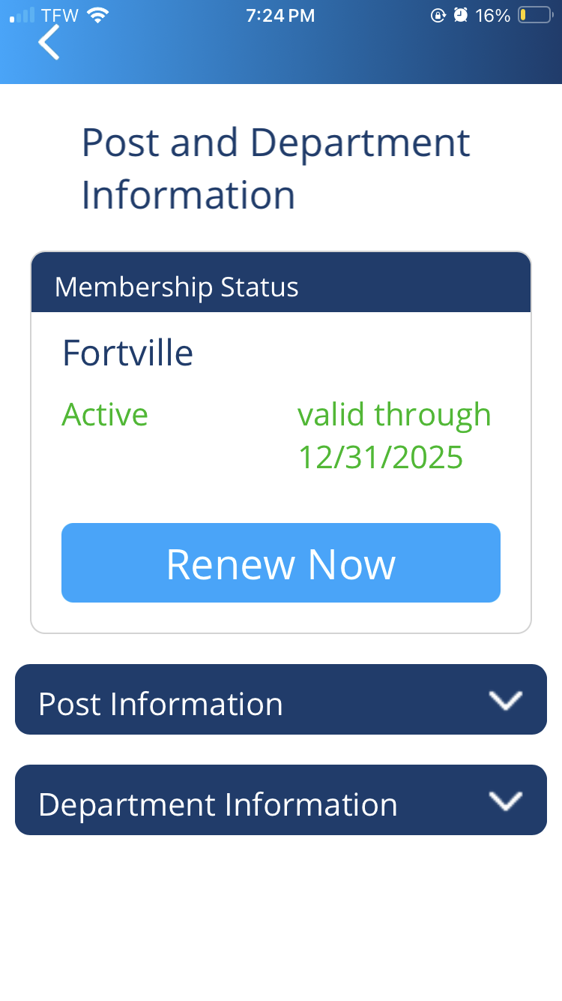
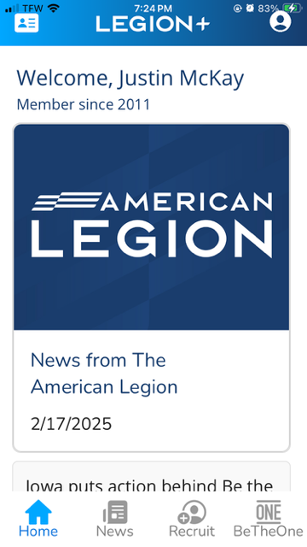
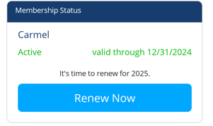
LEGION+
Welcome, Sam Sample
New Paris
New Paris
Expired Valid through 12/31/2026
Valid through 12/31/2026
It’s time to renew for 2027
3/11/2025
Notes:
A new mobile app has been launched call Legion plus. While in the Legion plus app, expired members can renew. Download and install the app on your mobile device and register with your membership ID number.

Slide 16
MULTI-YR PURCHASE
The American Legion’s multi-year membership offer is a pilot program. The pilot program will offer a 3-yr membership purchase. At the conclusion of the pilot program, it will be reassessed and brought back to the NEC for decision whether to continue or discontinue.
Legion members renewing online for 2027 can purchase a 3-year term, 2027, 2028, and 2029. www.legion.org/renew
New members joining online can purchase a 3-year membership through www.legion.org/join.
Notes:
The American Legion’s multi-year membership offer is a pilot program that offer 3-yr membership purchase. At the conclusion of the program, it will be reassessed and brought back to the NEC for decision whether to continue or discontinue.
<1> Legion members renewing online for 2027 can purchase 3-years of membership in one payment..
<2> New members joining online can purchase a 3-year membership through www.legion.org/join.

Slide 17
MULTI-YR PURCHASE
Can I purchase multi-year through my post?
No. Multi-year renewal is available for member online renew or online join. Post leadership cannot process multi-year payments via online post membership processing.
  www.legion.org/renew
  www.legion.org/join
When do I receive a membership card?
Post leadership can provide a membership card. The annual distribution of membership cards are mailed to departments from May-July. Posts are responsible for providing current membership cards to new and renewed members. Members can also print a current membership card through MyLegion.org.
Post leadership can view members who pay online using MyLegion reports or contacting department headquarters.
Notes:
<1> Post leadership cannot process multi-year payments via online post processing.
<2> Post leadership can provide a membership card. The annual distribution of membership cards are mailed to departments from May-July. Posts are responsible for providing current membership cards to new and renewed members. Members can also print a current membership card through MyLegion.org.
Post leadership can view members who pay online using MyLegion reports or contacting department headquarters.

Slide 18
MULTI-YR PURCHASE
What if my post dues increase?
The dues rate is locked at time of purchase. However, the post the member transfers into could require the member to pay the difference between dues paid in advance and current dues for the new post.
Can I receive a refund for future paid memberships?
No. Refunds are not available for multi-year purchases.
Notes:
<1> Dues rates are locked at the time of purchase. However, the post the member transfers into could require the member to pay the difference between dues paid in advance and current dues for the new post.
<2> Members who cancel membership or enter post everlasting will not receive a refund for multi-year purchases.

Slide 19
Contact your department or national Customer Support to assist with any questions or help with online renew.
800-433-3318
cs@legion.org
Notes:
If you have any issues or questions about renewing your membership online, contact your department or national customer support team.

